Slide 1
The Lord’s Prayer (submission and authority) John 17:1-5

Slide 2
The Lord’s Prayer (submission and authority) John 17:1-5
Ch.17 = “The Lord’s prayer”

Slide 3
The Lord’s Prayer (submission and authority) John 17:1-5
Ch.17 = “The Lord’s prayer”
People’s appreciation of Jesus

Slide 4
The Lord’s Prayer (submission and authority) John 17:1-5
Ch.17 = “The Lord’s prayer”
People’s appreciation of Jesus
Prayer – three principal sections

Slide 5
The Lord’s Prayer (submission and authority) John 17:1-5
Ch.17 = “The Lord’s prayer”
People’s appreciation of Jesus
Prayer – three principal sections
Situation and time unknown

Slide 6
The Lord’s Prayer (submission and authority) John 17:1-5
Ch.17 = “The Lord’s prayer”
People’s appreciation of Jesus
Prayer – three principal sections
Situation and time unknown
Jesus prayed frequently

Slide 7
The Lord’s Prayer (submission and authority) John 17:1-5
Jesus and his Father v.1
‘Father, the hour has come. Glorify your Son, that your Son may glorify you’.

Slide 8
The Lord’s Prayer (submission and authority) John 17:1-5
Jesus and his Father v.1
Their relationship

Slide 9
The Lord’s Prayer (submission and authority) John 17:1-5
Jesus and his Father v.1
Their relationship
The “hour”

Slide 10
The Lord’s Prayer (submission and authority) John 17:1-5
Jesus and his Father v.1
Their relationship
The “hour”
The request (sandwich) vv.1,4

Slide 11
The Lord’s Prayer (submission and authority) John 17:1-5
Jesus and his Father v.1
Their relationship
The “hour”
The request (sandwich) vv.1,4
Glory – really?

Slide 12
The Lord’s Prayer (submission and authority) John 17:1-5
Jesus and his Father v.1
Their relationship
The “hour”
The request (sandwich) vv.1,4
Glory – really?
We preach Christ crucified – 1 Cor.1:23-24

Slide 13
The Lord’s Prayer (submission and authority) John 17:1-5
Jesus and his Father v.1
His Father’s Ambassador v.2
‘For you granted him authority over all people that he might give eternal life to all those you have given him.’

Slide 14
The Lord’s Prayer (submission and authority) John 17:1-5
Jesus and his Father v.1
His Father’s Ambassador v.2
God’s sovereignty

Slide 15
The Lord’s Prayer (submission and authority) John 17:1-5
Jesus and his Father v.1
His Father’s Ambassador v.2
God’s sovereignty
God’s holiness & justice

Slide 16
The Lord’s Prayer (submission and authority) John 17:1-5
Jesus and his Father v.1
His Father’s Ambassador v.2
God’s sovereignty
God’s holiness & justice
God’s love, mercy and grace

Slide 17
The Lord’s Prayer (submission and authority) John 17:1-5
Jesus and his Father v.1
His Father’s Ambassador v.2
His supreme gift v.3
‘Now this is eternal life: that they know you, the only true God, and Jesus Christ, whom you have sent.’

Slide 18
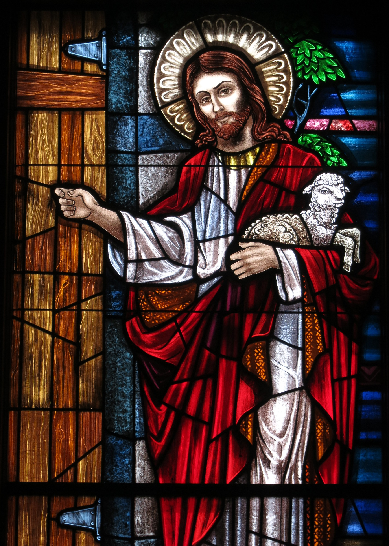
The Lord’s Prayer (submission and authority) John 17:1-5
Jesus and his Father v.1
His Father’s Ambassador v.2
His supreme gift v.3
Mistaken interpretation of Rev.3:20

Slide 19
The Lord’s Prayer (submission and authority) John 17:1-5
Jesus and his Father v.1
His Father’s Ambassador v.2
His supreme gift v.3
Mistaken interpretation of Rev.3:20
God’s sovereign grace

Slide 20
The Lord’s Prayer (submission and authority) John 17:1-5
Jesus and his Father v.1
His Father’s Ambassador v.2
His supreme gift v.3
Mistaken interpretation of Rev.3:20
God’s sovereign grace
Jesus’ work not in vain

Slide 21
The Lord’s Prayer (submission and authority) John 17:1-5
Jesus and his Father v.1
His Father’s Ambassador v.2
His supreme gift v.3
Mistaken interpretation of Rev.3:20
God’s sovereign grace
Jesus’ work not in vain
Lessons
The importance of prayers of submission

Slide 22
The Lord’s Prayer (submission and authority) John 17:1-5
Jesus and his Father v.1
His Father’s Ambassador v.2
His supreme gift v.3
Mistaken interpretation of Rev.3:20
God’s sovereign grace
Jesus’ work not in vain
Lessons
The importance of prayers of submission
The importance of evangelism

Slide 23
The Lord’s Prayer (submission and authority) John 17:1-5
Jesus and his Father v.1
His Father’s Ambassador v.2
His supreme gift v.3
Mistaken interpretation of Rev.3:20
God’s sovereign grace
Jesus’ work not in vain
Lessons
The importance of prayers of submission
The importance of evangelism
Paul’s example: 2 Tim.2:10

Slide 24
The Lord’s Prayer (submission and authority) John 17:1-5
Jesus and his Father v.1
His Father’s Ambassador v.2
His supreme gift v.3
Mistaken interpretation of Rev.3:20
God’s sovereign grace
Jesus’ work not in vain
Lessons
The importance of prayers of submission
The importance of evangelism
Paul’s example: 2 Tim.2:10
Daniel’s example: Daniel 9:4-19

Slide 25
The Lord’s Prayer (submission and authority) John 17:1-5
Jesus and his Father v.1
His Father’s Ambassador v.2
His supreme gift v.3
Mistaken interpretation of Rev.3:20
God’s sovereign grace
Jesus’ work not in vain
Lessons
The importance of prayers of submission
The importance of evangelism
Paul’s example: 2 Tim.2:10
Daniel’s example: Daniel 9:4-19
Worship of God’s courtiers around throne: Rev.5.9-10

